Slide 1

Hierarchical Text Classification
Dino Tan 1003368, Ong Li-Chang 1003328, Suhas Sahu 1003370, Noorbakht Khan 1003827

Slide 2
Content
Show offensive Tweets (images) and explain the problem (show current Twitter measure implemented) (Noor)
Explain how we aim to make the current measure that is implemented better (Project motivation) (Noor)
Describe dataset (Suhas)
Data visualisation/exploration
Data Preprocessing
Evaluation Metrics - F1 Macro, Recall (Noor)
Choosing of text representation - TFIDF / Word2Vec / GloVe (Dino/Chang)
1 slide (for stats + neural network model results -- combine)
Stats Models and Results and Justifications (Suhas/Noor)
Neural Network Models and Results and Justifications (Dino/Chang)
Evaluation on a separate dataset (using best models for A, B & C)
Further Improvements
Demo of UI

Slide 3
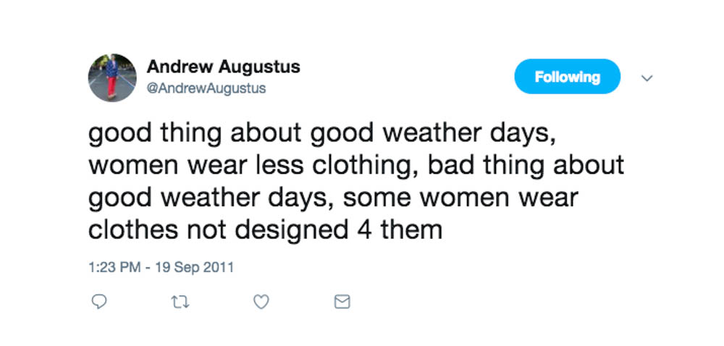
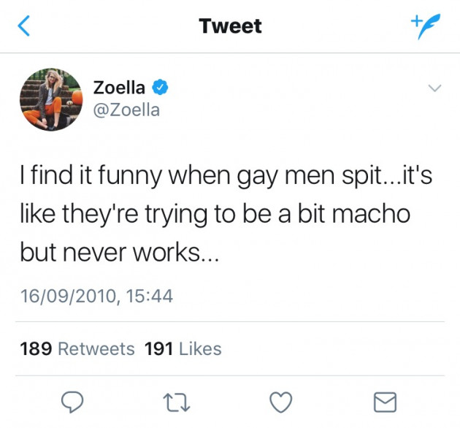
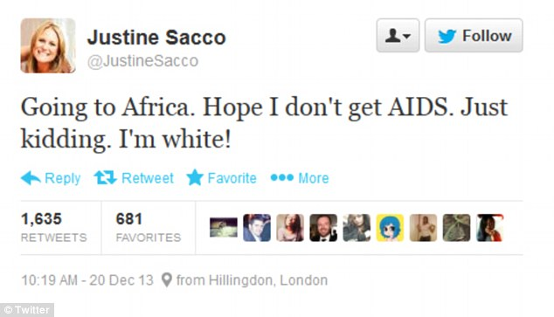
Problem Scoping

Slide 4
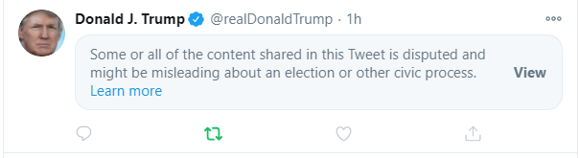
Problem Scoping
Social Media has the power to influence many. Over ⅓ of the world is on Facebook alone
Twitter has a disproportionate amount of abuse, a study of 134,000 abusive social media mentions showed that 88% of them occur on Twitter
Allowing these posts to remain online will promote a hostile environment
Currently, Twitter only censors tweets that are posted, there is no system to pre-warn posters if their tweet is offensive

Slide 5
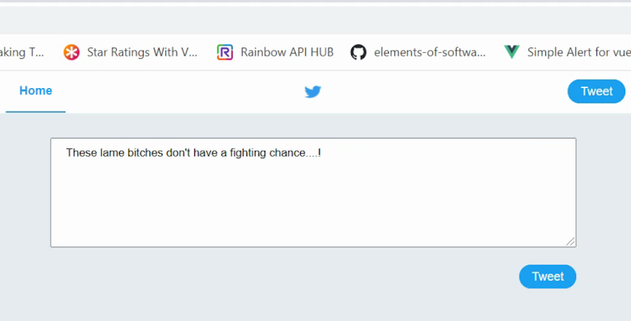
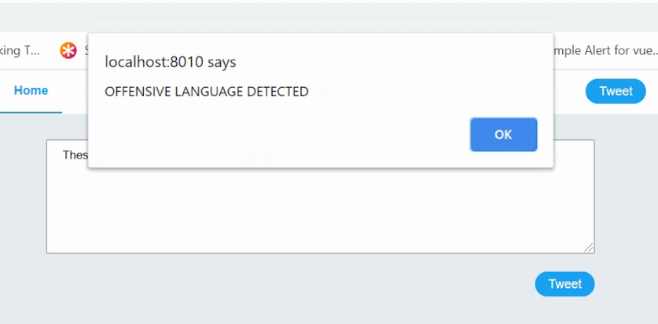
Our Solution
An early warning system that sounds off to users if their tweet is offensive before their post goes out. This shifts the responsibility to the tweeter and forces them to think about their actions

Slide 6
Dataset
Offensive Language Identification Dataset (OLID) -Hierarchical Dataset (13,240 Tweets)
TIN
Task C
OFF
Task B
Task A
UNT
NOT
IND
OTH
GRP
Task A → Contains tweets that are labelled as either Offensive or Not Offensive.
Task B → Contains tweets that are labelled as either Targeted or Untargeted.
Task C→ Contains tweets that are labelled as either targeted to an Individual, a Group or Others.

Slide 7
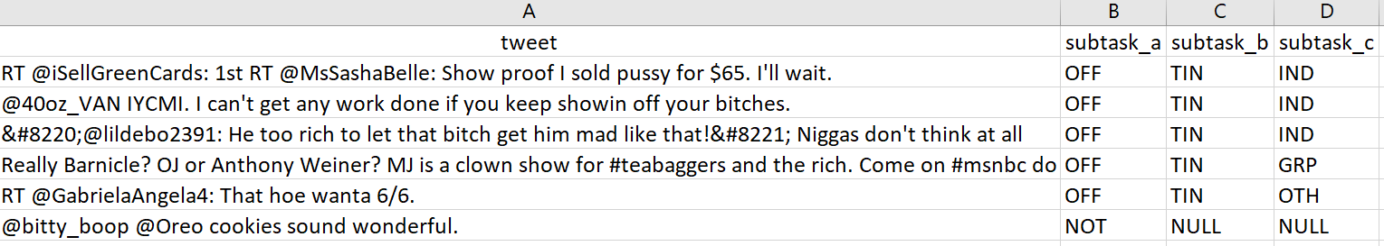
OFFENSIVE
TARGETED
INDIVIDUAL

Slide 8
OFFENSIVE
TARGETED
OTHERS

Slide 9
NOT OFFENSIVE

Slide 10
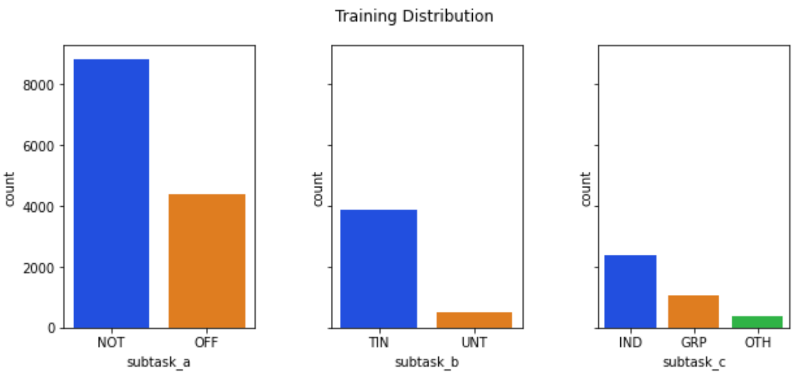
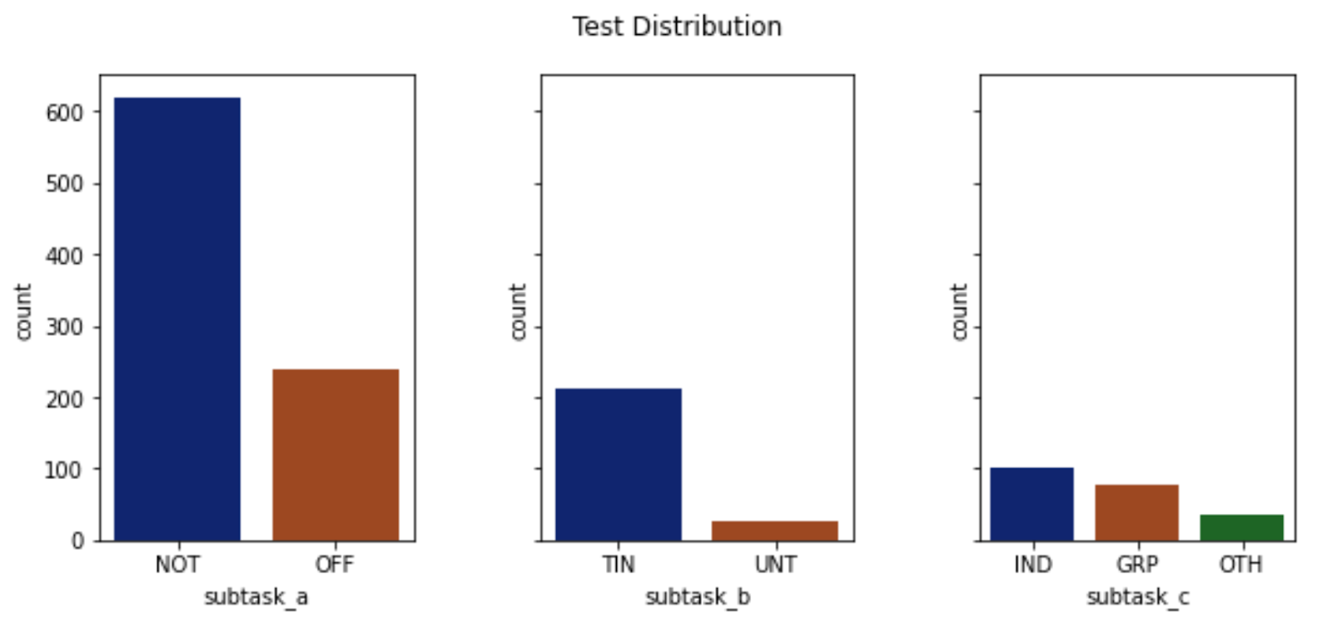
Data Visualisation (Class Distribution)
Training Distribution
Test Distribution

Slide 11
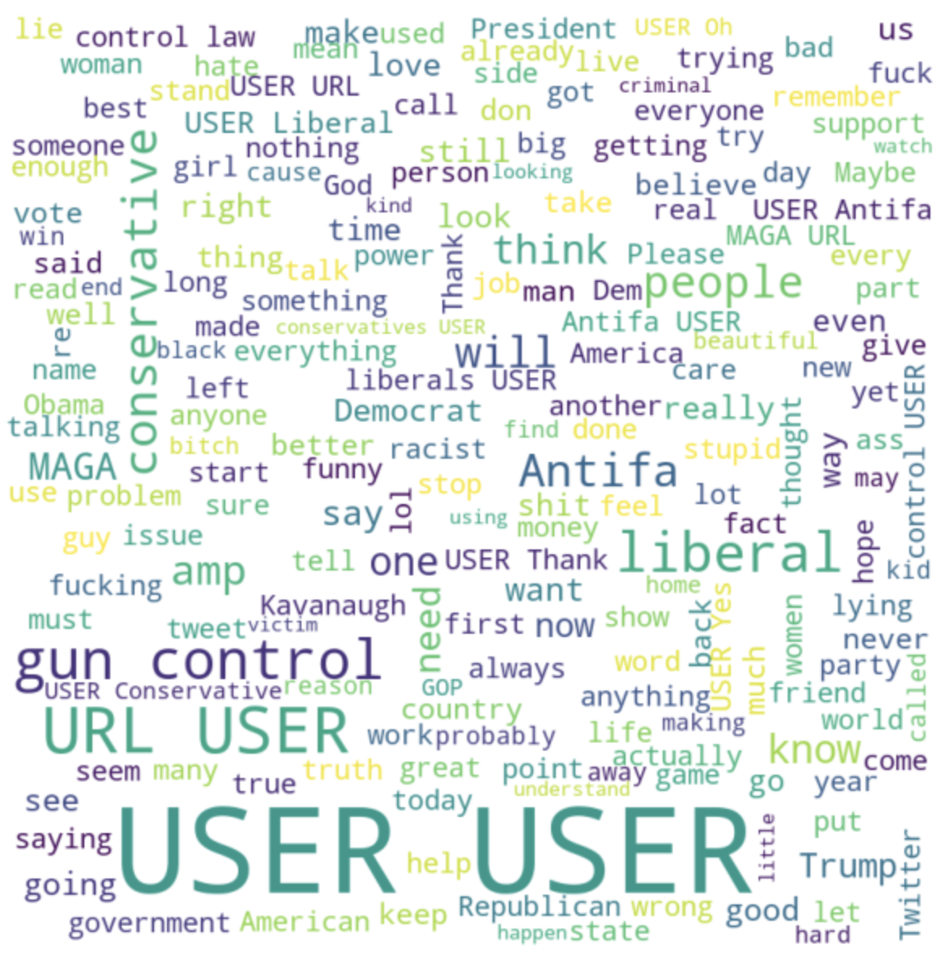
Data Visualisation (Initial Word Cloud)
Notes:
American Politics
Bias of dataset towards tweets from the united states
URL Tags replaces the urls in the tweets

Slide 12
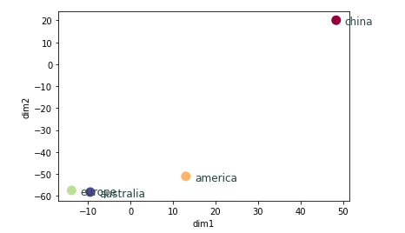
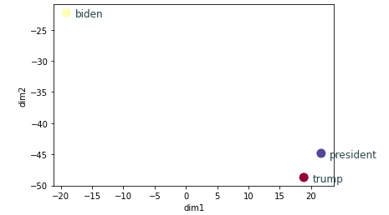
Data Visualisation (TSNE)
Geopolitical Contextualisation
American Politics
Notes:
Captures geopolitical usage of the words
Representation of American politics

Slide 13
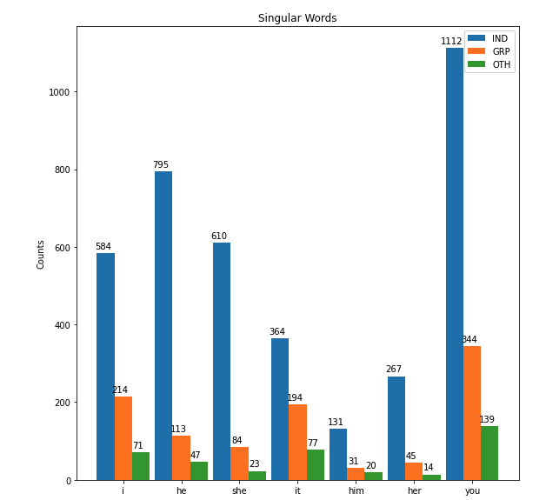
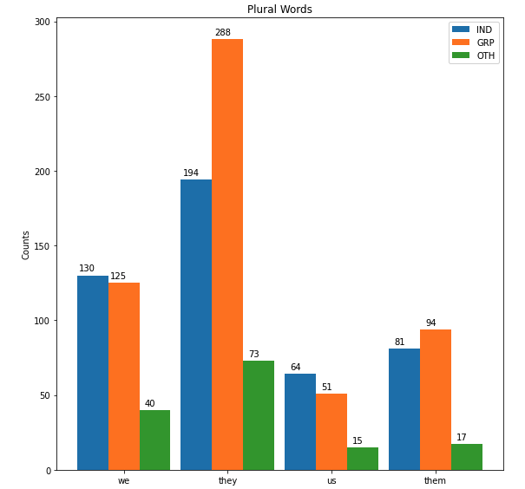
Data Visualisation (Singular & Plural)
Singular Words
Plural Words
Helpful for Level B (Targetted, Untargeted)
Helpful for Level C (Individual, Group, Other)
Notes:
Captures geopolitical usage of the words
Representation of American politics
Useful for stopword inclusion for subtask b and c

Slide 14
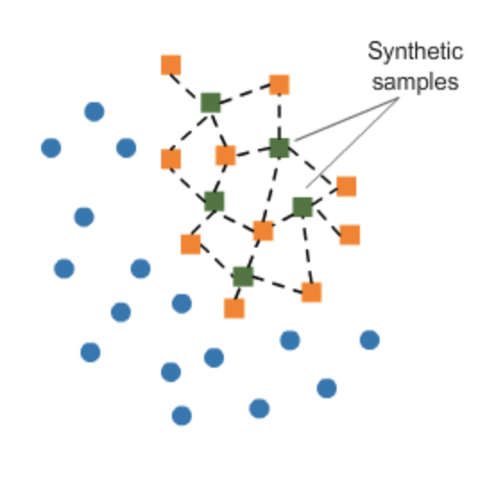
Tweet Preprocessing (Balancing Data)
Problem
Imbalanced Data
Solution
SMOTE
Notes:
SMOTE synthesises new minority instances between existing minority instances

Slide 15
Tweet Preprocessing (Data Cleaning)
Removal of Hashtags, Reserved Words, Emojis
Removal of Punctuations and Numbers
Changing to Lowercase
Handling Apostrophe
Spelling
Correction
Lemmatization
Stop Word Removal
Notes:
Given that by this step the spelling of the words had been corrected, we felt that Lemmatization was the better choice. This was especially so as Lemmatization would generate words that are from the actual language, for instance, in Stemming ‘ponies’ would become ‘poni’ but by Lemmatizing, we would get ‘pony’. The typical challenge for Lemmatization is in developing the Lemmatizer, but as we were dealing with tweets in English, we could tap on existing Lemmatizers such as the one present in the NLTK library.

Slide 16
Tweet Preprocessing (Data Cleaning)
Removal of Hashtags, Reserved Words, Emojis
Removal of Punctuations and Numbers
Changing to Lowercase
Common on platforms such as Twitter & Facebook
SymSpell library
Fixes misspelled words
Handling Apostrophe
Spelling
Correction
Lemmatization
Stop Word Removal
Notes:
Given that by this step the spelling of the words had been corrected, we felt that Lemmatization was the better choice. This was especially so as Lemmatization would generate words that are from the actual language, for instance, in Stemming ‘ponies’ would become ‘poni’ but by Lemmatizing, we would get ‘pony’. The typical challenge for Lemmatization is in developing the Lemmatizer, but as we were dealing with tweets in English, we could tap on existing Lemmatizers such as the one present in the NLTK library.
Actually emojis quite useful

Slide 17
Tweet Preprocessing (Data Cleaning)
Removal of Hashtags, Reserved Words, Emojis
Removal of Punctuations and Numbers
Changing to Lowercase
Handling Apostrophe
Spelling
Correction
Appended and removed some words
Appended
“she”, “he”, “they”
Removed
“URL”
Lemmatization
Stop Word Removal
Notes:
Given that by this step the spelling of the words had been corrected, we felt that Lemmatization was the better choice. This was especially so as Lemmatization would generate words that are from the actual language, for instance, in Stemming ‘ponies’ would become ‘poni’ but by Lemmatizing, we would get ‘pony’. The typical challenge for Lemmatization is in developing the Lemmatizer, but as we were dealing with tweets in English, we could tap on existing Lemmatizers such as the one present in the NLTK library.

Slide 18
Evaluation Metrics
Subtask A (OFFENSIVE or NOT OFFENSIVE) | Subtask B (TARGETED or UNTARGETED) | Subtask C (INDIVIDUAL, GROUP, OTHERS)
Recall | F1 Macro | F1 Macro
Subtask A → Higher importance given to ensuring that tweets are classified as ‘Offensive’ → Recall
Subtask B → Equal importance given to ‘Un-targeted’ or ‘Targeted’ tweets → F1 Macro
Subtask C → Equal importance given to tweets aimed at ‘Individual’, ‘Group’ or ‘Others’ → F1 Macro

Slide 19
Theoretical Findings
Text Representation
TF-IDF | Word2Vec | GloVe
How it works: Provides a scoring scheme for words, measures how important a word is to a document Pros: Simple and effective Cons: Not able to account for word position, semantics and co-occurrence with other words. Computationally slow for large documents. | How it works: Unsupervised model for generating vectors. Works by doing incremental, 'sparse' training of a neural network. Pros: Retains semantic meaning of different words in a document Cons: Difficulty handling unknown/OOV words. No shared representation at sub word level | How it works: Same purpose as Word2Vec but GloVe works to fit vectors to model a giant word co-occurrence matrix built from the corpus. Pros: Same as Word2Vec but had a higher average performance to efficiency ratio. Cons: Same as Word2Vec

Slide 20
Experiment on Validation Set
Results | A - Recall (OFFENSIVE) | B - F1 Macro | C - F1 Macro
TF-IDF | 0.68 | 0.59 | 0.50
Word2Vec | 0.64 | 0.51 | 0.38
GloVe | 0.55 | 0.50 | 0.37
* We were surprised to see that TF-IDF was the best Text Representation method during our validation testing. However when we ran our models on test data, TF-IDF produced very bad results. This prompted us to further experiment with GloVe and Word2Vec. At the end, GloVe ywas more consistent and yielded the best results.

Slide 21
Stats Model Selection - 10-fold cross validation
 | Subtask A | Subtask B | Subtask C
 | Recall (Offensive Class) | F1 Macro | F1 Macro
XGBoost | 0.649 | 0.866 | 0.682
Logistic Regression | 0.610 | 0.686 | 0.501
SVM (polynomial for A & B, radial basis function for C) | 0.656 | 0.802 | 0.647
Ada Boosting | 0.612 | 0.750 | 0.484
Gaussian Naive Bayes | 0.606 | 0.688 | 0.488
Random Forest Classifier | 0.685 | 0.868 | 0.699
Gradient Boosting | 0.610 | 0.716 | 0.545
Notes:
Chose a value of k=10 for cross validation as it has been found through experimentation to generally result in a model skill estimate with low bias and a modest variance. Random Forest Classifier, XGBoost & SVM works well so we decided to proceed with these 3 models for our test data

Slide 22
Evaluation of Results on Test Dataset
 | Subtask A | Subtask B | Subtask C
 | Recall (Offensive Class) | F1 Macro | F1 Macro
Random Forest Classifier | 0.37 | 0.56 | 0.37
SVM (polynomial for A & B, radial basis function for C) | 0.47 | 0.51 | 0.43
XGBoost | 0.46 | 0.52 | 0.40
SVM → Best Classifier for subtask A and C→ Ability to learn is independent of the dimensionality of feature space. Able to generalise even in the presence of many features, if data is separable with a wide margin using functions from the hypothesis.
Random Forest Classifier → Best classifier for subtask B → less susceptible to overfitting & helps to deal with noisy data present.
XGBoost → works well generally for all subtasks → Individual models are not built on completely random subsets of data and features but sequentially by putting more weight on instances with wrong predictions and high errors. The general idea behind this is that instances, which are hard to predict correctly will be focused on during learning, so that the model learns from past mistakes.
Notes:
SVMs is that their ability to learn can be independent of the dimensionality of the feature space. SVMs measure the complexity of hypotheses based on the margin with which they separate the data, not the number of features. This means that we can generalize even in the presence of very many features, if our data is separable with a wide margin using functions from the hypothesis space
Random Forest Classifier works best → deals with noisy data present & prevents overfitting. XGBoost → ensemble method that works by boosting trees. SVM → When learning text classifiers, one has to deal with very many (more than 10000) features. Since SVMs use overtting protection, they have the potential to handle these large feature spaces.

Slide 23
Basis of Neural Network Selection
CNN
CNN and Max Pooling helps us extract higher level features in sentences.
LSTM
LSTM circumvents vanishing gradient problem of RNNs in capturing long term dependencies
Bidirectional LSTM
Hypothesize experimenting with BiLSTM which can capture information from two opposite directions of a sentence to make full use of the contextual information.
Self Attention
In a tweet, not all contextual words have equal contribution to semantics. To address this, a self-attention mechanism is used reweigh word vector embeddings by relating words in each tweet,
to give more context to the sentence.
Notes:
https://ieeexplore.ieee.org/stamp/stamp.jsp?arnumber=8922599
https://www.youtube.com/watch?v=yGTUuEx3GkA

Slide 24
Basis of Neural Network Layers
CNN
CNN and Max Pooling helps us extract higher level features in sentences.
LSTM
LSTM circumvents vanishing gradient problem of RNNs in capturing long term dependencies
BiLSTM
Hypothesize experimenting with Bidirectional LSTM which can capture information from two opposite directions of a sentence to make full use of the contextual information.
Self Attention (Offensive Determination)
In a tweet, not all contextual words have equal contribution to semantics. To address this, a self-attention mechanism is used reweigh word vector embeddings by relating words in each tweet
To give more context to the sentence.
OFFENSIVE: “ That bitch needs to die”
Bitch + Die gives context of offensiveness
NOT OFFENSIVE: “I am dying for some chocolate cake”
Dying + Cake / Dying + Chocolate gives context of non offensiveness
Notes:
https://ieeexplore.ieee.org/stamp/stamp.jsp?arnumber=8922599
https://www.youtube.com/watch?v=yGTUuEx3GkA

Slide 25
Neural Network Model Results
SUBTASK | BEST NEURAL NETWORK MODEL | METRICS | STATS MODEL BENCHMARK
A | BiLSTM + Self Attention + CNN | Recall (OFFENSIVE) : 0.53 | Recall (OFFENSIVE): 0.47
B | CNN + LSTM | Macro F1: 0.52 | Macro F1: 0.56
C | CNN + BiLSTM | Macro F1: 0.56 | Macro F1: 0.43
Neural Network for Subtask A and C outperformed statistical models
Self Attention did not seem to perform well for Subtask B and C. May be attributed to too minute sample sizes
Applying dropout after activation of convolutional layers and within LSTM layers seemed to produce better results
Notes:
Chose a value of k=10 for cross validation as it has been found through experimentation to generally result in a model skill estimate with low bias anda modest variance.

Slide 26
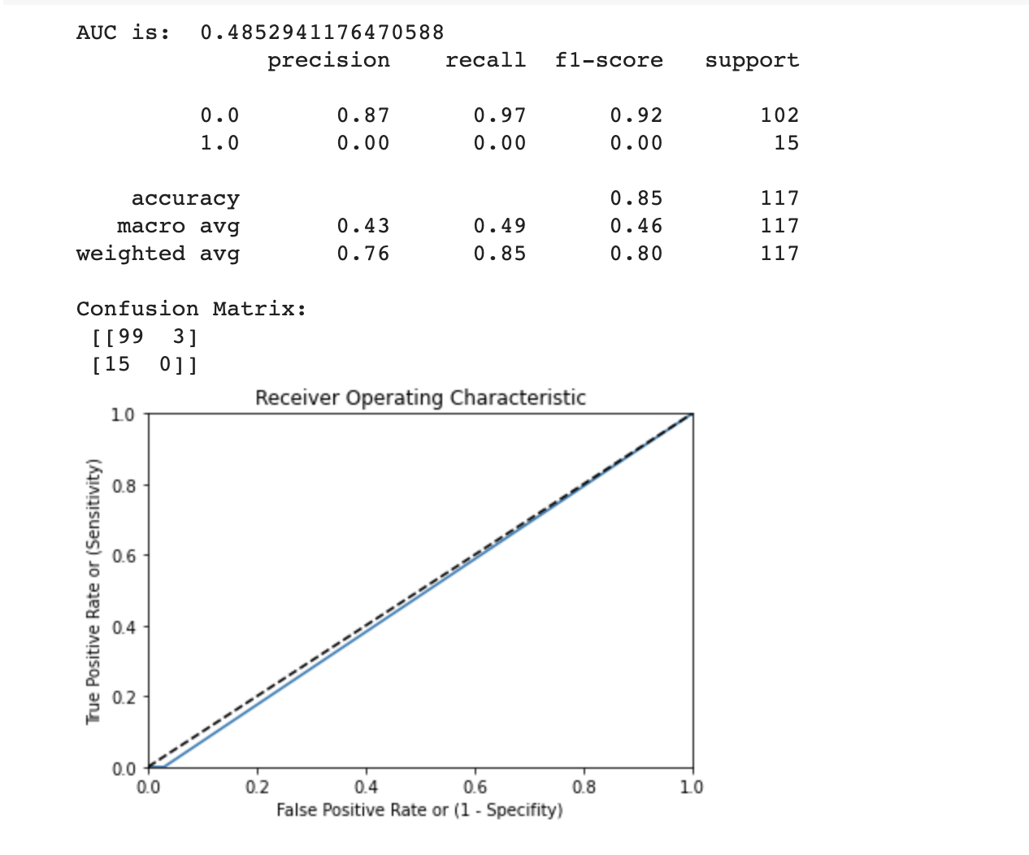
Performance on the custom test case B

Slide 27
Model Evaluation on New Data
Further evaluate our best models on public data, to observe if preprocessing and tuning helps in generalising models to unseen data.
Manually labelled 200 Tweets. Generic offensive and non offensive tweets not skewed towards any event or demographic in particular.

Slide 28
Public Dataset Results (Best Performing Models)
MODEL | SUBTASK A (OFFENSIVE/ NOT OFFENSIVE) | SUBTASK B (TARGETED/ UNTARGETED) | SUBTASK C (GRP/IND/OTHER)
 | (BiLSTM-SelfAttention-CNN) | (RANDOM FOREST) | (CNN-LSTM)
F1 Macro | 0.64 | 0.46 | 0.40
Recall | OFF: 0.81 NOT: 0.46 | TIN: 0.64 UNT:0.33 | GRP: 0.21 IND:0.91 OTH: 0.12
Evaluated Metrics in Green
Model performs relatively well for subtask A compared to B and C

Slide 29
Reflection
Improvements
Test and Training Dataset have many tweets pertaining to American politics. (Overfitting)
Small sample of subtask B and C makes it difficult for complex models (Overfitting)
Subtask C (Individual, Group, Others) in OLID dataset does not appear to be labelled in a standardized manner
Incorporation of emoji description to improve tweet classifications and sentiments towards offensive vs not offensive tweets
Usage of more powerful word vector representations (FastText, BERT)

Slide 30
UI DEMO

